Slide 1
Colors for Recording
#FDC3A9 LIGHT ORANGE
#fb7f47 DARK ORANGE
#b6c4e0 LIGHT BLUE
#132e57 DARK BLUE
Notes:
FSPBI0B – Your Role as a BI Developer
Seb Voice(?) Recording

Slide 2

Trading Dashboard in Tableau

Slide 3
Congratulations – You have a new role.
Congratulations! You have been hired by CFI Capital Partners as a Business Intelligence Analyst!
CFI Capital Partners An investment bank with a particular focus on trading US stocks
Definitions
Stocks Represents a small share of a company owned by the shareholder.
Stock Exchange A market-place where securities such as stocks are listed, bought and sold.
New York Stock Exchange (NYSE) and NASDAQ Both examples of stock exchanges.
Stock Index An index made up of a selection of stocks that represent a segment of the economy.
Dow Jones A stock index made up of 30 leading US stocks on the NASDAQ or NYSE.
Notes:
FSPBI0B – Your Role as a BI Developer
Seb Voice(?) Recording

Slide 4
Head of Sales & Trading - Kurt
Oh hi! Great to have you on board. I’m, Kurt Loafie – I lead the sales and trading team here at CFI Capital Partners. These are exciting times. We’re hoping to develop new trading strategies through the use of analytics. I’ve heard a thing or two about your data skills from my colleagues and we’re stoked to have you.
For context, our trading team is always looking for new ways to analyze the market. We’re really desperate for some dashboards to show daily trading insights. We’re kind of sold on Tableau on our dashboarding tool but we need to develop a proof of concept to get the budget approved.
I need you to show what we could do with a customized dashboard. Show off all the great features, inspire us to go beyond the usual analysis we do. Start simple with candlesticks, Bollinger bands etc, and you can throw in a few of your own ideas too.
Our data engineer put together a sample data warehouse, with stock, prices, dates, market caps. I’ll send you the documents. With a bit of luck, you’ll build something, we’ll get the budget secured and we’ll have a new suite of reports for our traders.
I have to run. Elon’s tweeted. Call me when you have something.
Notes:
FSPBI0B – Your Role as a BI Developer
Seb Voice(?) Recording

Slide 5
Project Requirements
Kurt has asked you to create a Tableau Trading Dashboard for the Sales & Trading team.
Below are your requirements based on the discussions with Kurt, and the rest of the team.
Your Tasks
Connect to the test database using the documents provided
Use Tableau to create a proof of concept trading dashboard
Show off the best features of Tableau
The Visuals
Include a Candlestick Chart
Include a Bollinger Band visual
Include the other visuals requested by the team
Notes:
FSPBI0C – Video Call with Project Sponsor
Meeyeon Video Recording

Slide 6
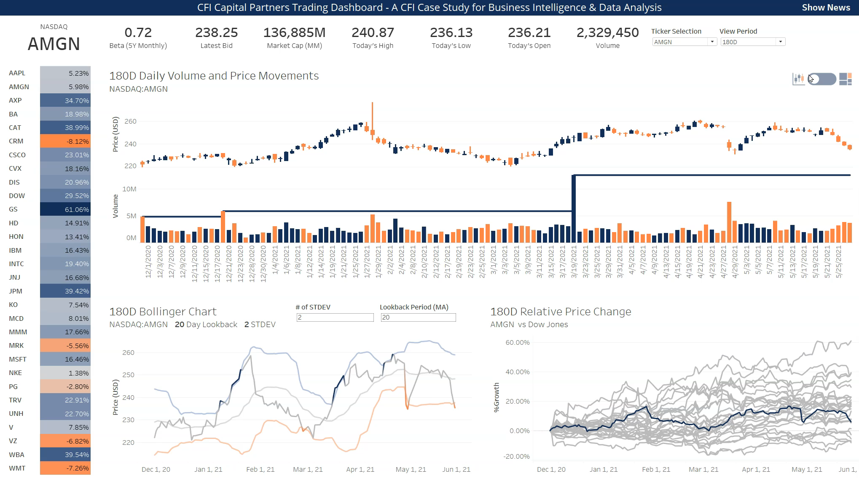
Project Requirements Part 1
The final product will include:
Candlestick Chart
Dynamic Bollinger Bands
Volume Chart
Previous Volume High
Relative Growth Chart
Total Growth Table Slicer
Dynamic View Period Selection
Ticker Selection
Notes:
FSPBI0C – Video Call with Project Sponsor
Meeyeon Video Recording

Slide 7
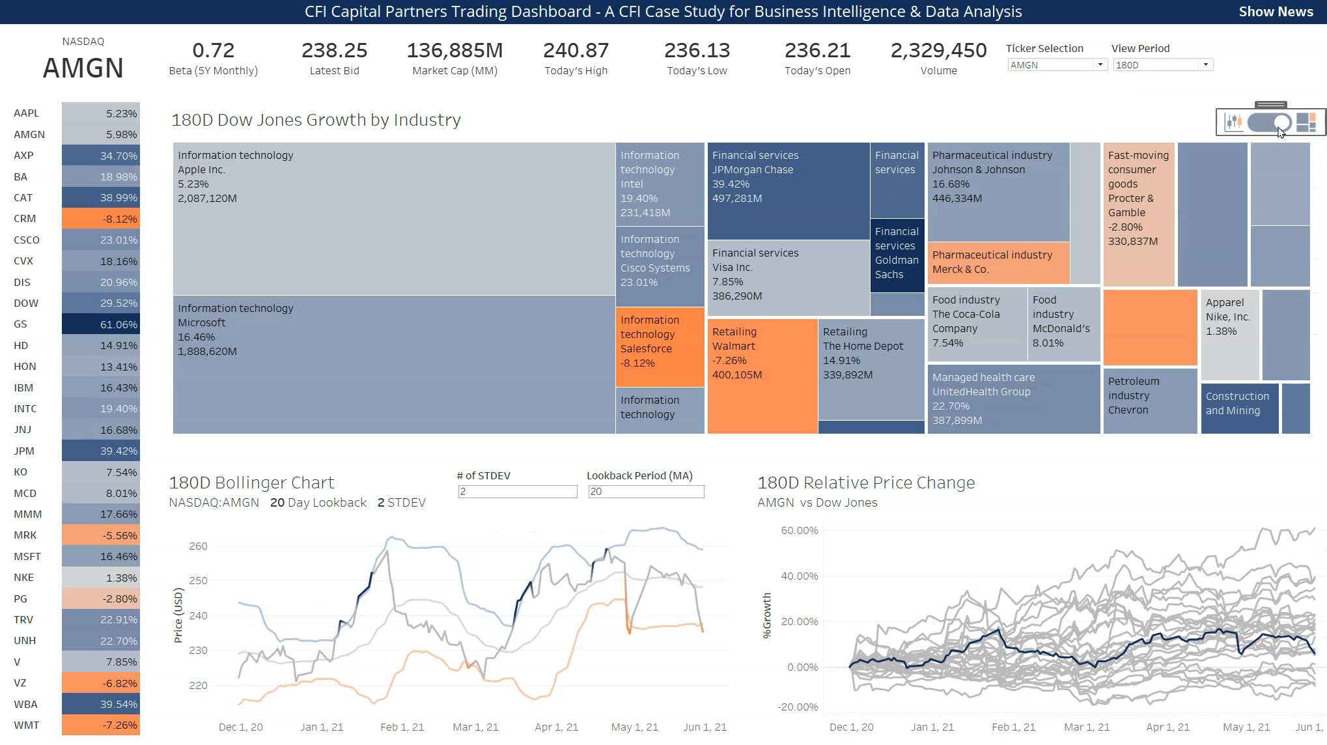
Project Requirements Part 2
In addition, you will include:
Pop-up Containers for
Industry & Ticker Treemap
Notes:
FSPBI0C – Video Call with Project Sponsor
Meeyeon Video Recording

Slide 8
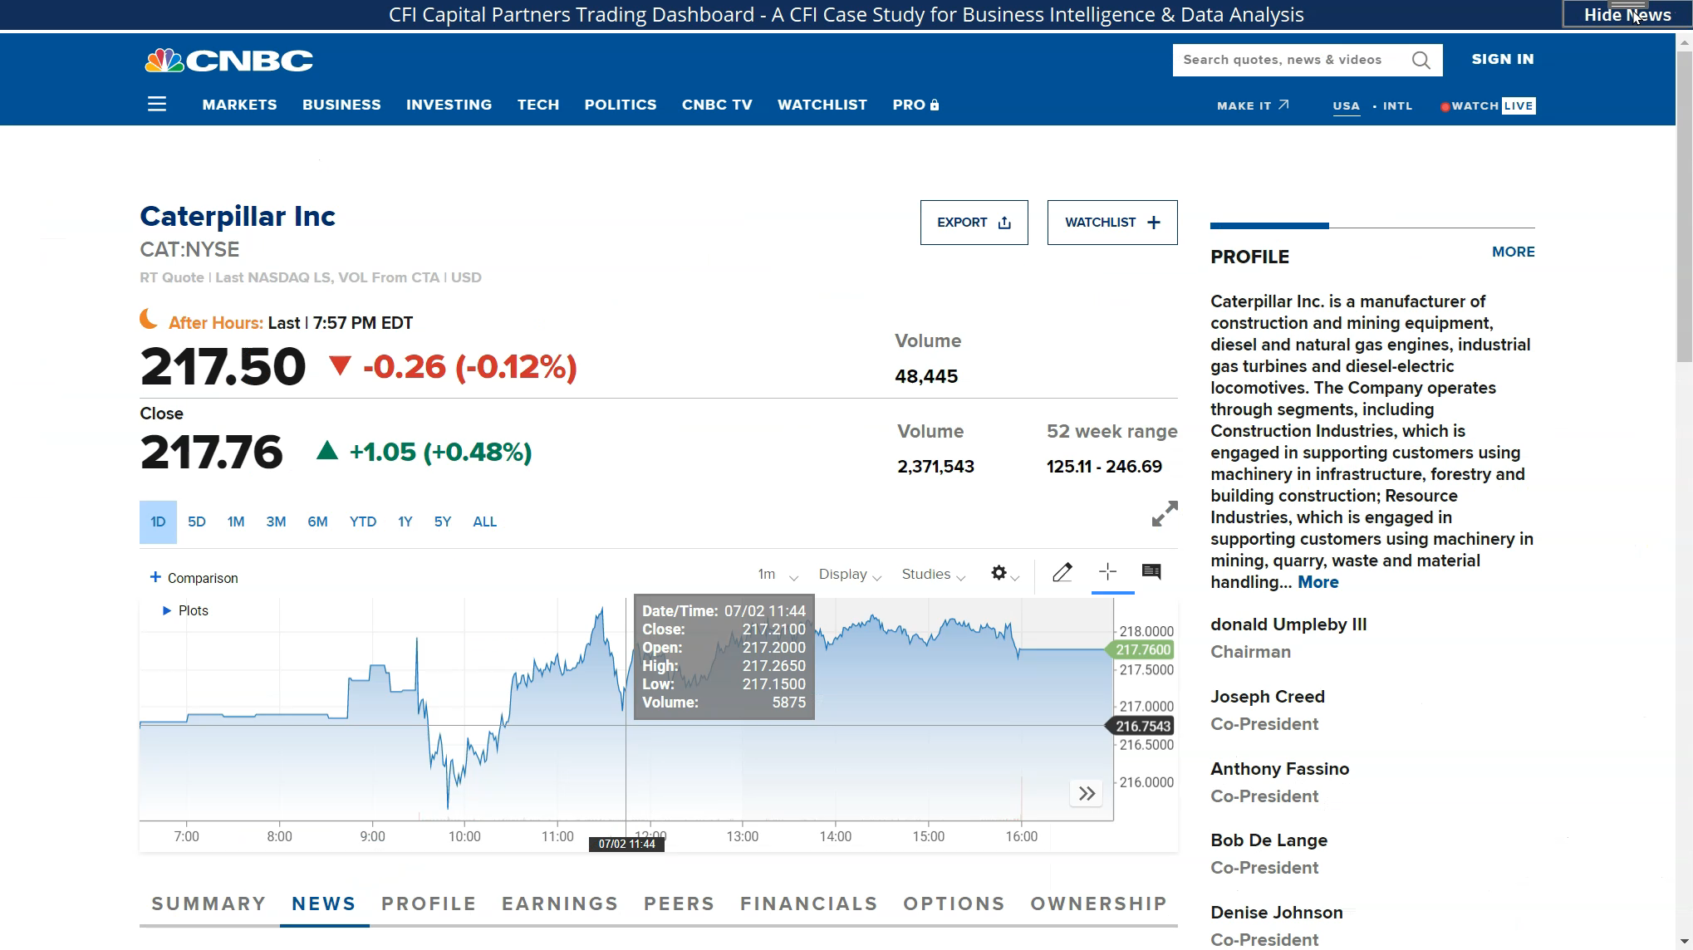
Project Requirements Part 3
In addition, you will include:
Pop-up Containers including
Ticker Response News Feed
Parameter Actions
To use the heat table as a slicer for the rest of the dashboard
Notes:
FSPBI0C – Video Call with Project Sponsor
Meeyeon Video Recording

Slide 9
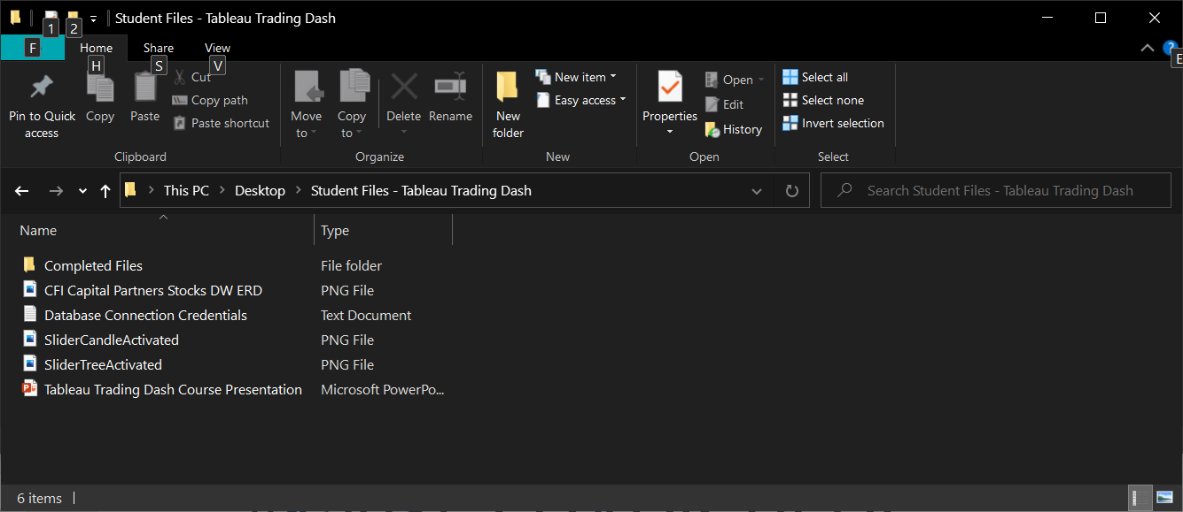
Student Files - Tableau Trading Dashboard
Notes:
FSPBI0F Course Files Overview

Slide 10
Key Concepts – Order of Operations
Data Source Filters
Filters cccc
Context Filters
Top N, Sets, Conditional Filters & Fixed LOD
Dimension Filters
Include / Exclude LOD, Data blending
Measure Filters
Table Calcs, Totals, Forecasts

Slide 11
Key Concepts – Parameters

Slide 12
Key Concepts – Table Calculations

Slide 13
Key Concepts – Parameter Actions

Slide 14
Trading Dashboard in Tableau - Case Study Approach
Pull Historical Prices into Tableau
Create Visuals for Intraday Prices
Create Trading Dashboard
Create Visuals for Historical Prices
Pull Intraday Prices into Tableau
Azure Data Studio
Azure Data Studio
Tableau
Tableau
Tableau

Slide 15
Trading Dashboard in Tableau - Case Study Approach
Pull Historical Prices into Tableau
Create Visuals for Intraday Prices
Create Trading Dashboard
Create Visuals for Historical Prices
Pull Intraday Prices into Tableau
Azure Data Studio
Azure Data Studio
Tableau
Tableau
Tableau

Slide 16

Pull Historical Prices into Tableau

Slide 17


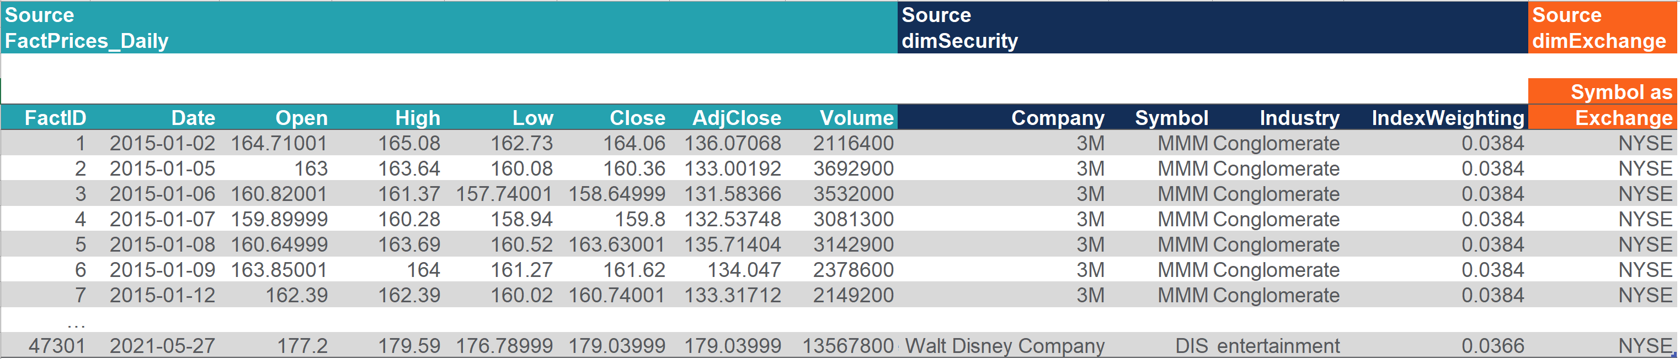
Task List: Pull Historical Prices Into Tableau
1. Connect to the database using Azure Data Studio
2. Explore the database using the ERD and Azure interface
3. Write a query to return Historical Stock prices from the database
4. Finally, import the data to Tableau by querying the view called vHistoricalPricesReporting
Notes:
This is for the course landing page and student handout PFD. The instructor does not need to record this slide.

Slide 18
Database Connection Details
Use the following connection details in Azure Data Studio or Excel to connect to the data.
Server: prod-sql-cfieducation.database.windows.net
Username: ReportingUser
Pass: CFICapitalPartners789#
Database: StockPricesDW
Notes:
FSPBI0F Course Files Overview

Slide 19
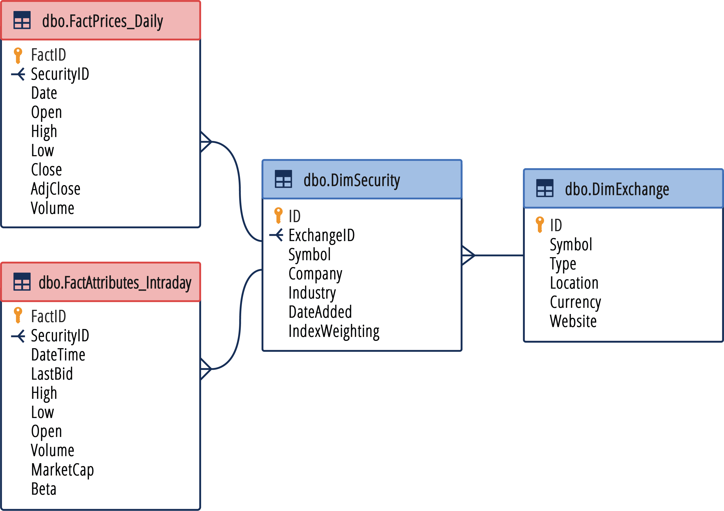
ERD – CFI Capital Partners StockPricesDW
Use the Entity Relationship Diagram to help you understand the database structure and write your queries.
Notes:
FSPBI0F Course Files Overview

Slide 20
Student Task Review: Write a Query for Historical Prices
Below is the final query required to source historical data from the database.
SELECT
hist.FactID,
hist.Date,
hist.[Open],
hist.High,
hist.Low,
hist.[Close],
hist.AdjClose,
hist.Volume,
sec.Company,
sec.Symbol,
sec.Industry,
sec.IndexWeighting,
exc.Symbol AS Exchange
FROM [dbo].[FactPrices_Daily] AS hist
INNER JOIN [dbo].[dimSecurity] AS sec
ON hist.SecurityID = sec.ID
INNER JOIN [dbo].[dimExchange] AS exc
ON sec.ExchangeID = exc.ID
Creating a view
To make life simpler for the database administrator, we can prepare the full code required to create the view.
To do this, we can wrap the query in the following code:
CREATE VIEW vHistoricalPricesReporting
AS
QUERY HERE
GO
Notes:
FSPBI0F Course Files Overview

Slide 21
Trading Dashboard in Tableau - Case Study Approach
Pull Historical Prices into Tableau
Create Visuals for Intraday Prices
Create Trading Dashboard
Create Visuals for Historical Prices
Pull Intraday Prices into Tableau
Azure Data Studio
Azure Data Studio
Tableau
Tableau
Tableau

Slide 22

Create Visuals for Historical Prices

Slide 23
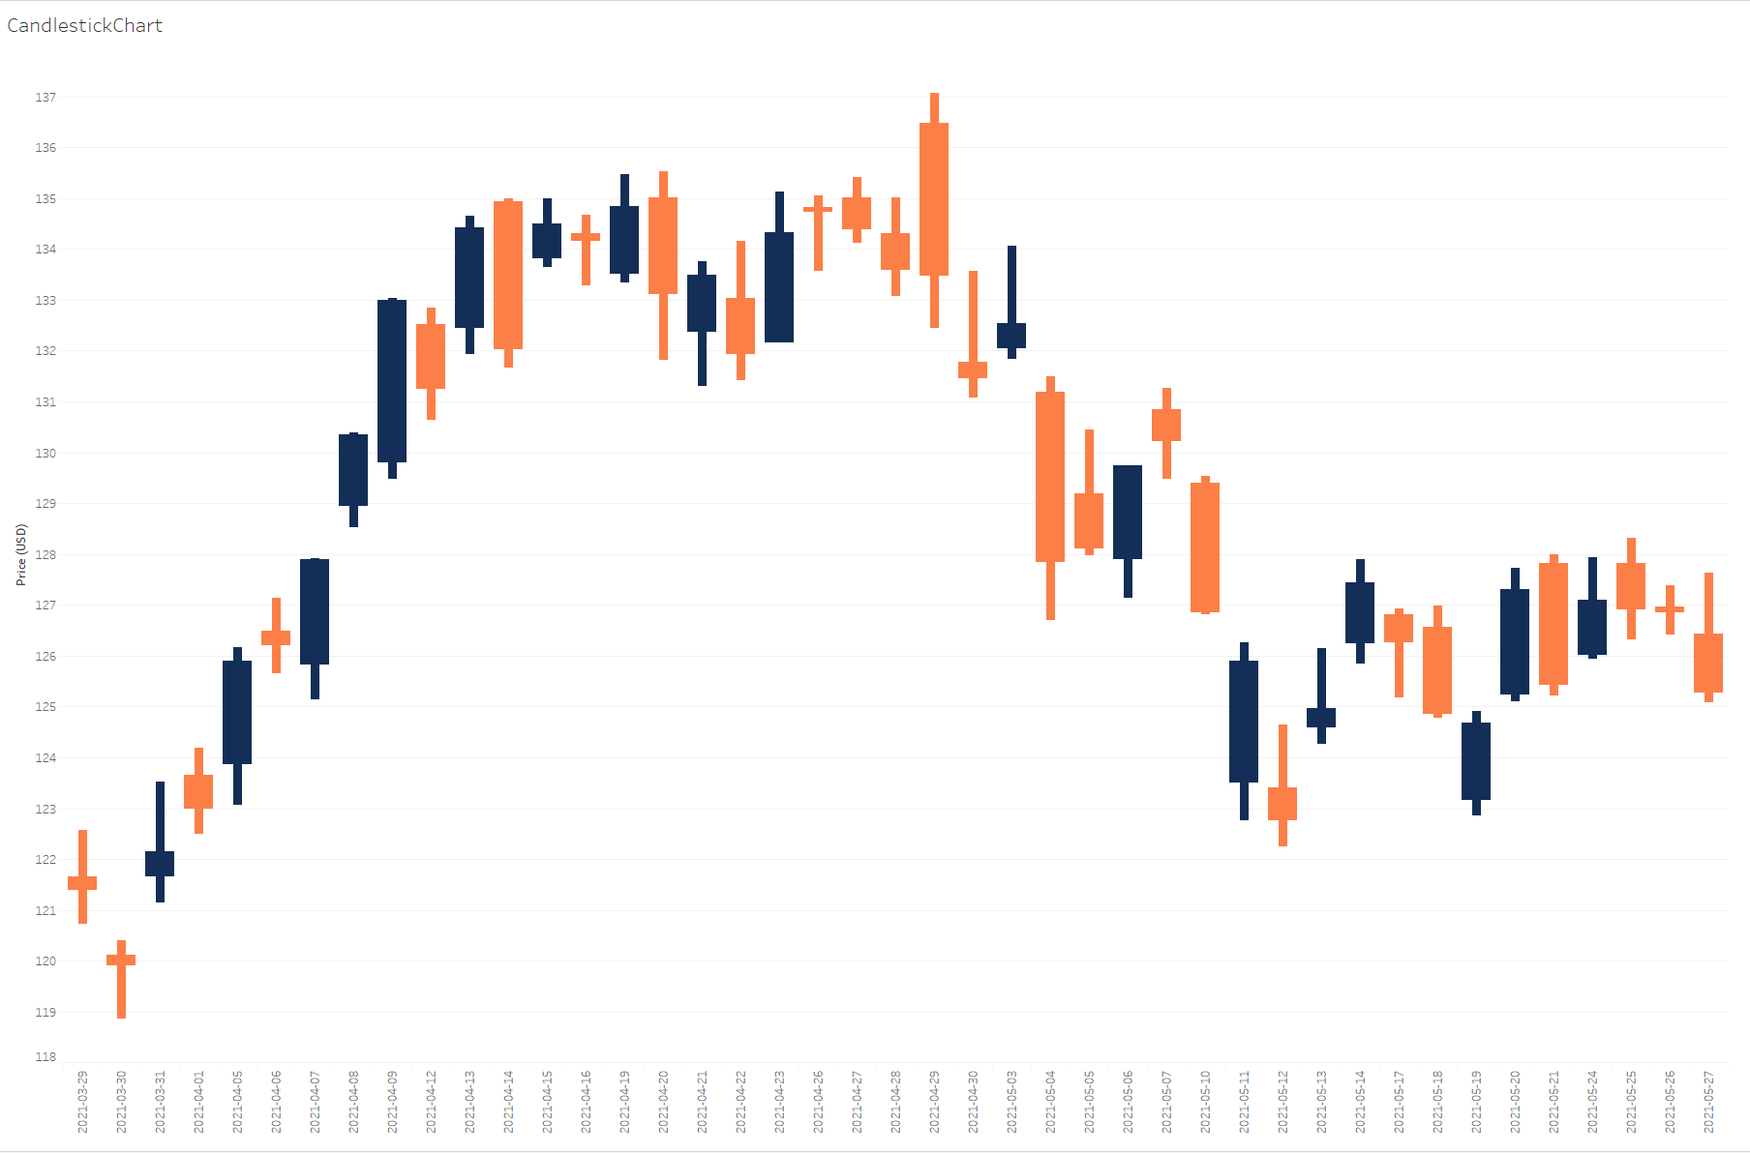
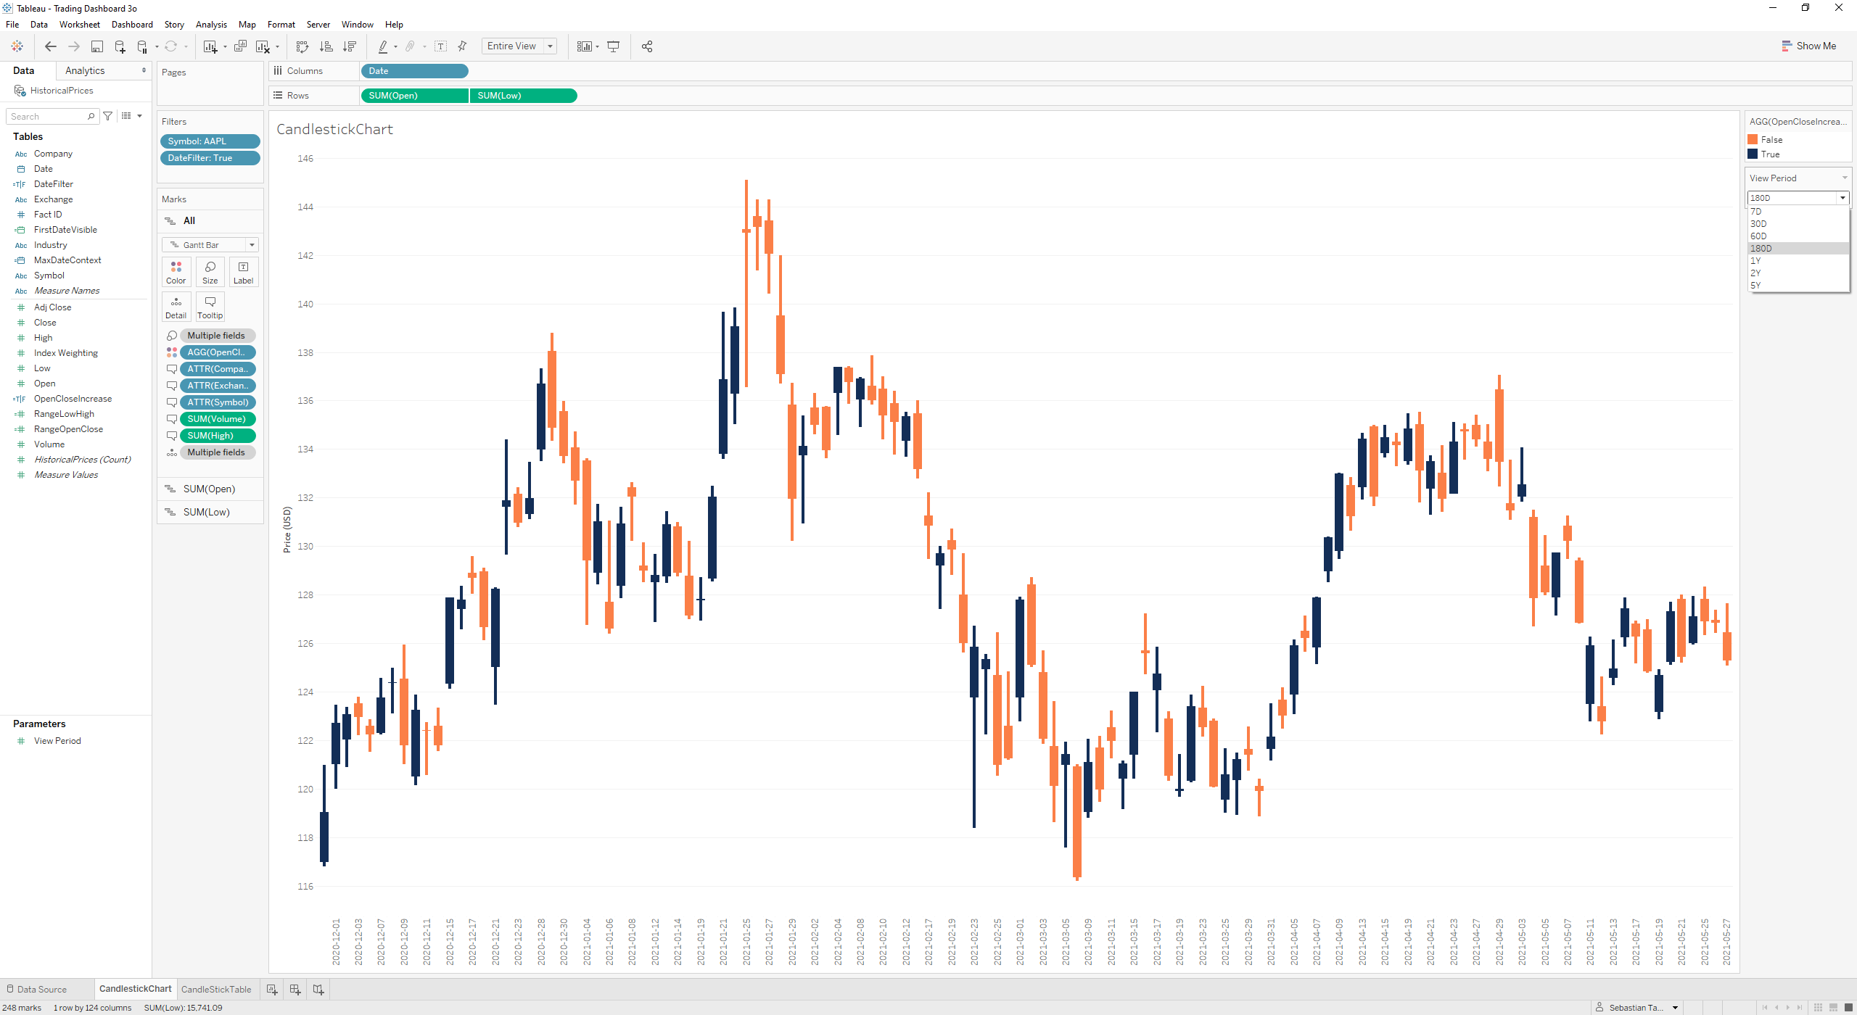
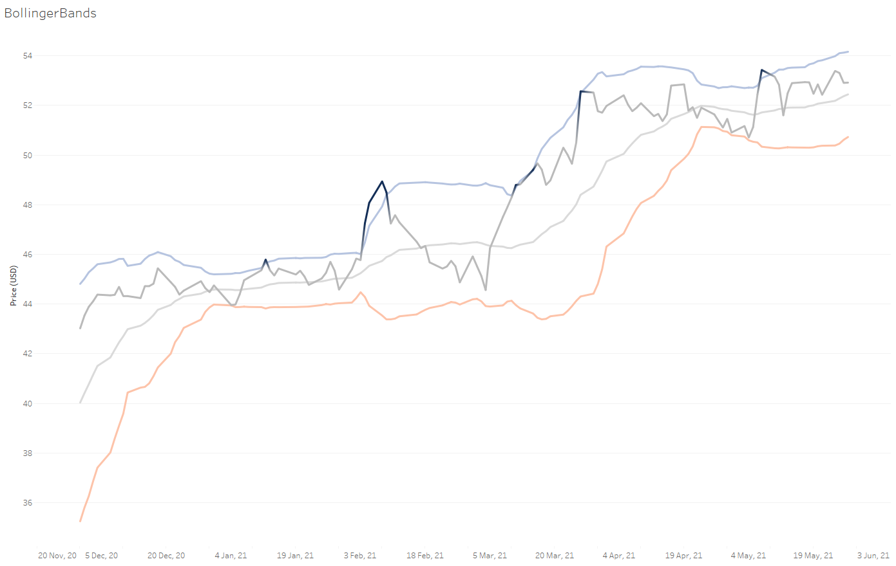
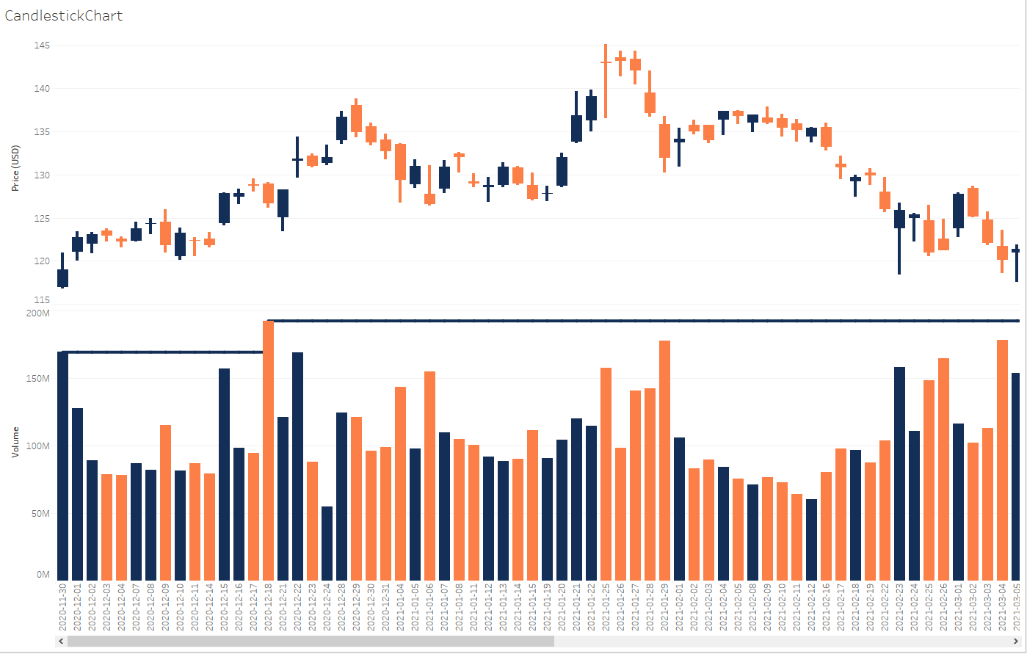
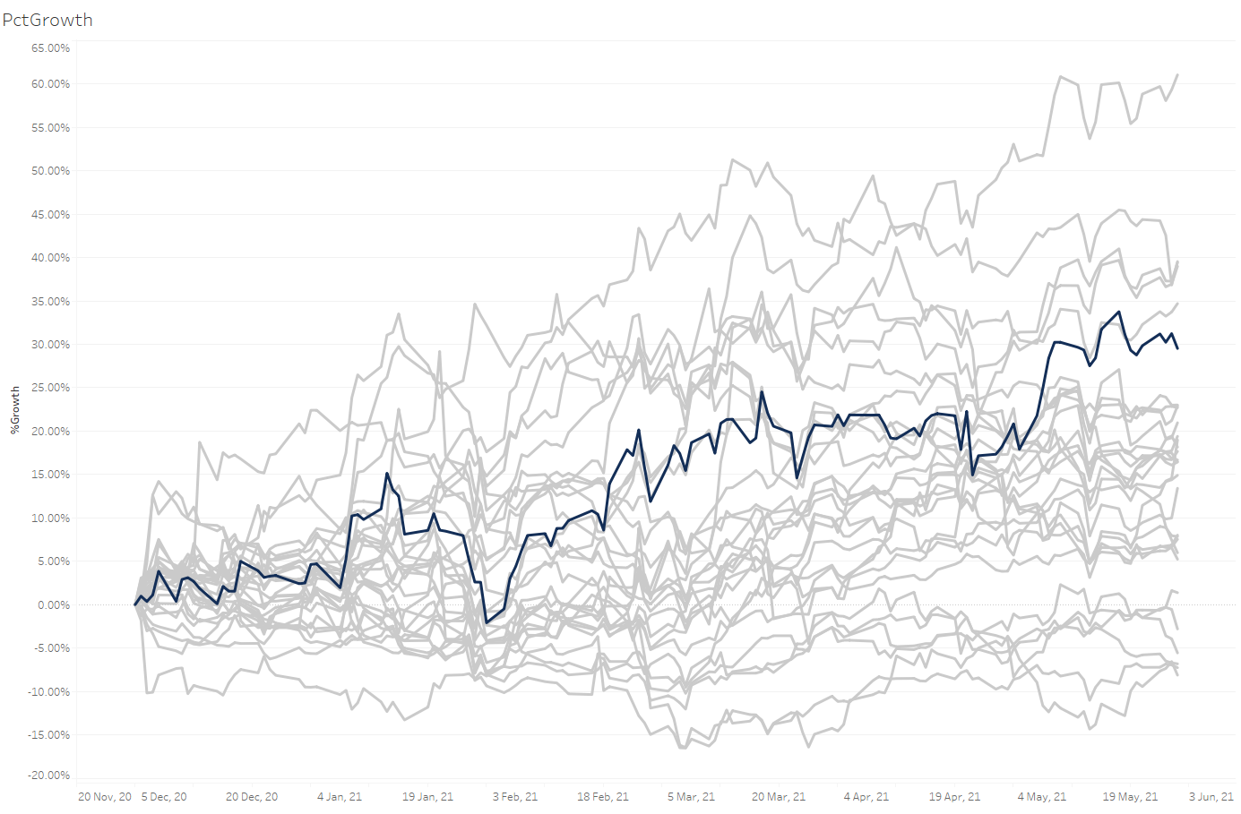
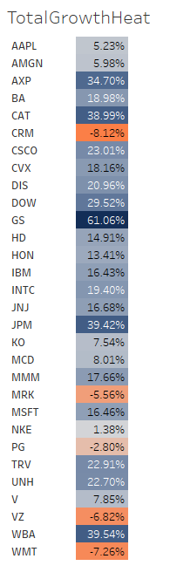
Task List: Create Visuals for Historical Prices
1. Create a Candlestick chart
2. Use parameters to create a user selected Viewing Period
3. Create a Bollinger Bands chart
4. Create a Traded Volume and Previous Volume High chart
5. Create a Relative Growth chart
6. Create a Total Growth Heat table
Notes:
This is for the course landing page and student handout PFD. The instructor does not need to record this slide.

Slide 24
Task 1. Candlestick Chart - Basics
A candlestick chart describes the range of price movements over a given period.
Each candle represents one day or another defined period of time.
The size of the candle body and wicks describes the price movements.
Upper Wick
Highest Price (High)
Closing Price (Close)
Body
Opening Price (Open)
Lower Wick
Lowest Price (Low)
Candlestick colors tell us the general direction of price movements.
Close > Open
Close < Open
Three common color schemes are used
Notes:
FSPBI0F Course Files Overview

Slide 25
Task 1. Candlestick Chart - Interpretation
Long blue bodies indicate strong buying pressure. The longer the body, the further the close price is above the open price.
B
A
A
B
Long orange bodies suggest strong selling pressure. In this second example, the close price is well below the open.
C
C
A long lower wick tells us that that sellers drove the price down, before prices recovered later in the day.
Notes:
FSPBI0F Course Files Overview

Slide 26
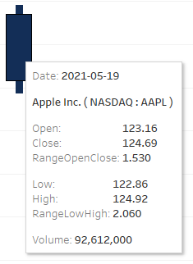
Task 1. Candlestick Chart - Requirements
Create the following candle stick chart in Tableau.
Exact dates along the X axis
Candlestick body represents Open & Close price
Candlestick wicks represents Low & High price
Color coded candles
Filter by Ticker
Clean look & feel
Tooltips as described in the picture
#132e57 DARK BLUE if Close > Open
#fb7f47 DARK ORANGE if Close < Open
Notes:
FSPBI0F Course Files Overview

Slide 27
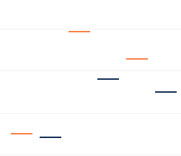
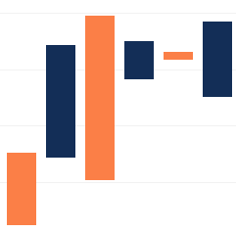
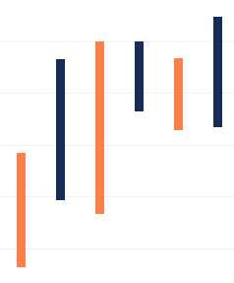
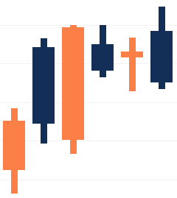
Task 1. Candlestick Chart - Requirements
It can be helpful to think of the candlestick chart as two separate box plots. One for the body, one for the wicks.
a) Plot body as Gantt bar
b) Body size = Close - Open
c) Wick size = High - low
d) Plot body & wick together
Notes:
FSPBI0F Course Files Overview

Slide 28
Task 1. Candlestick Chart - Calculations
Calculations Formula Type Used For
Open None Original Data Used to define body start point
RangeOpenClose Close – Open Decimal Used for body size
Low None Original Data Used to define wick start point
RangeLowHigh High – Low Decimal Used for wick size
OpenCloseIncrease Close > Open Boolean Used for candle color identification
Notes:
FSPBI0F Course Files Overview

Slide 29
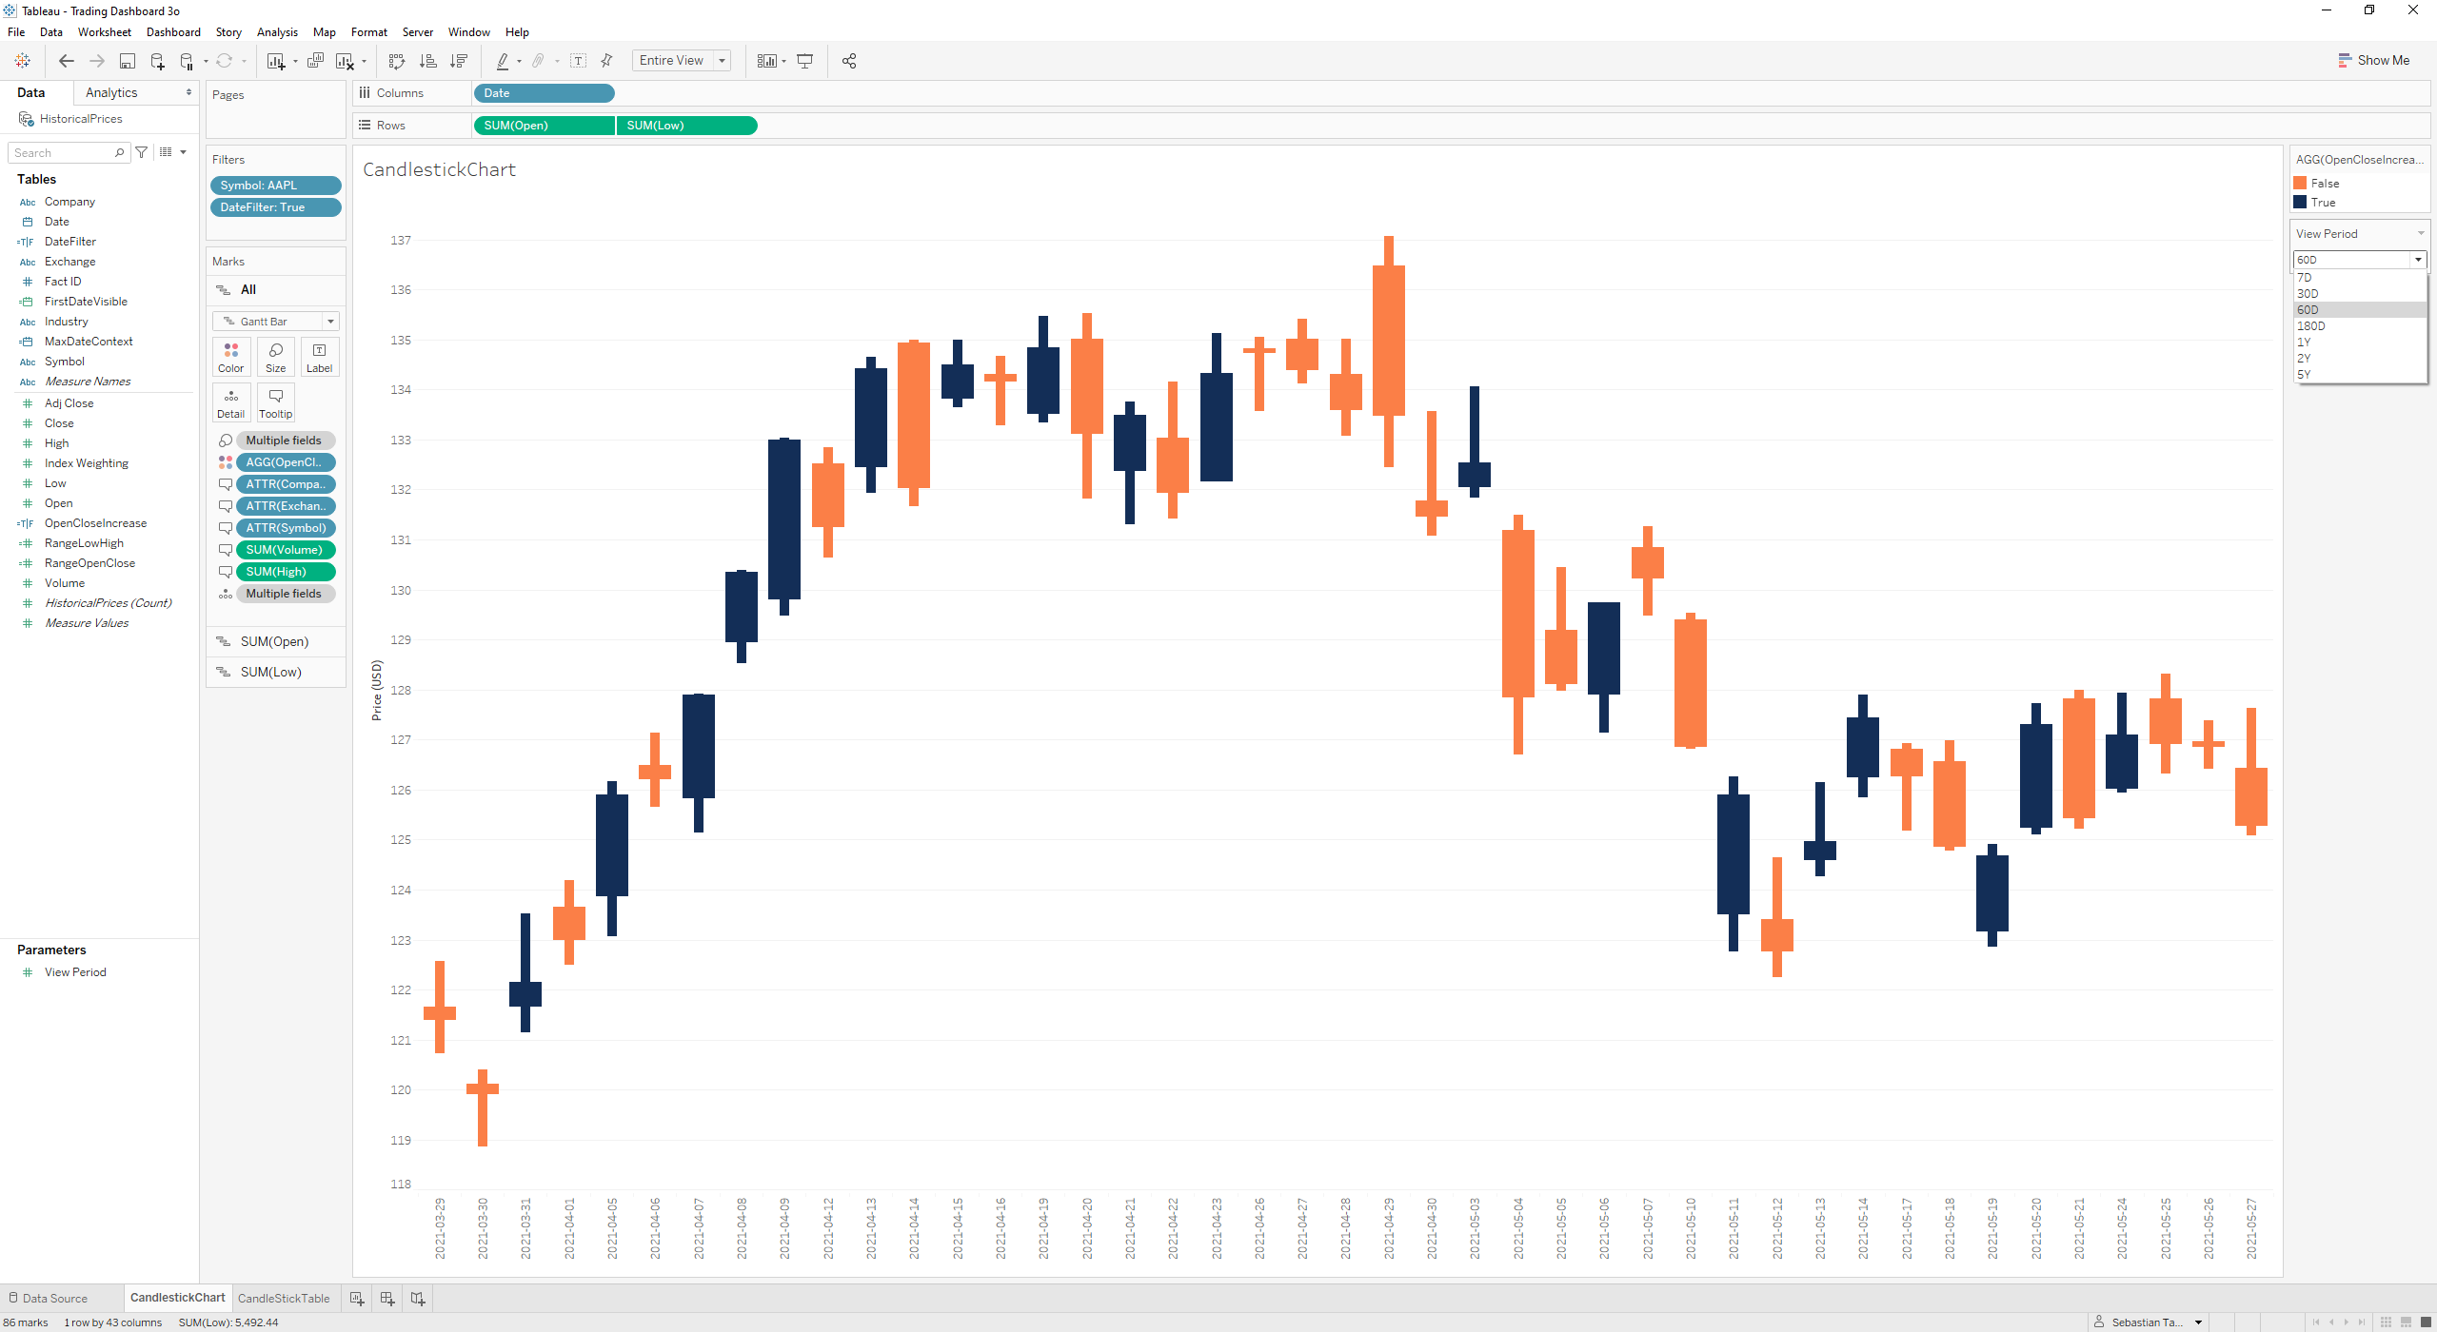
Task 2. Dynamic Date Selection - Requirements
Provide users with an interactive parameter drop down to select the viewing period.
The viewing period represents the most recent N days or years available in the data.
Notes:
FSPBI0F Course Files Overview

Slide 30
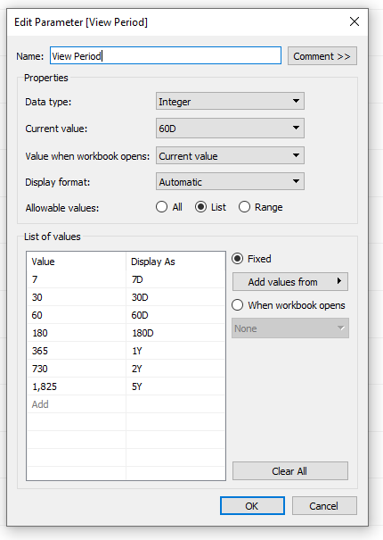
Task 2. Dynamic Date Selection - Calculations
Use the following calculations and parameters to create a dynamic date selection
1) Create a parameter called ViewPeriod to allow user selection of most recent days
2) Calculate the latest date in the dataset
MaxDateContext = {Max([Date])}
3) Calculate the first date required in the dataset based on the selection
[MaxDateContext] - ([View Period] -1)
4) Create a True False Calculation to use as a filter
DateFilter = [Date] >= [FirstDateVisible]
5) Place DateFilter on the Filter Pane and keep only values that are true.
Notes:
FSPBI0F Course Files Overview

Slide 31
Task 3. Bollinger Bands - Basics
Bollinger Bands are volatility bands placed above and below a N day moving average.
Volatility is calculated using the standard deviation over the same N day period.
Bollinger bands are plotted 2 or X number of standard deviations above or below the moving average.
Upper Bollinger Measure = MA + 2 S.D
Lower Bollinger Measure = MA – 2 S.D
The bands will automatically widen when volatility increases and contract when volatility decreases.
When the closing price moves outside of the Bollinger bands, we call this a breakout.
Notes:
FSPBI0F Course Files Overview

Slide 32
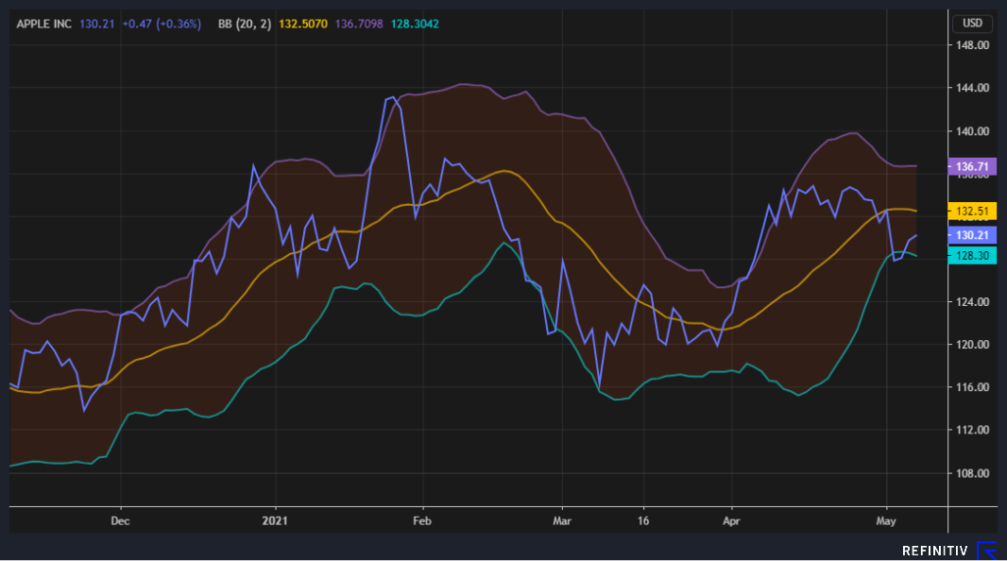
Task 3. Bollinger Bands - Interpretation
MA smooths out the price data and give us a better idea of the overall trend, i.e. “removes the noise”
Bollinger bands help us visualize recent levels of volatility in a stock price.
Prices are considered relatively high when above the upper band.
Prices are considered relatively low when below the lower band.
As prices move above and below the moving average, and breakout of the Bollinger bands, this helps make buy and sell decisions.
To learn more about technical analysis, check out CFI’s course on Trading using Technical Analysis.
Period of high volatility
relatively high price
Period of low volatility
relatively low price

Slide 33
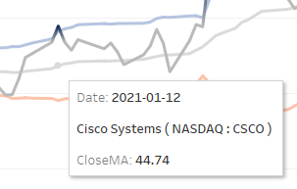
Task 3. Bollinger Bands - Requirements
Create the following Bollinger Band chart in Tableau.
Continuous timeline of exact dates along the X axis
Filter by ticker
Close Price
20 Day Moving Average Close Price using WINDOW_AVG()
Bonus: Dynamic # of MA Days using parameter
Calculate 20 Day Standard Deviation WINDOW_STDEV()
Upper Bollinger & Lower Bollinger Bands at 2 STDEV
Bonus: Dynamic # of S.D using parameter selection
Filter by date periods like the candlestick chart
Clean look & feel
Tooltips as described
Bonus: Dynamic highlight when price breakouts of bands
Notes:
FSPBI0F Course Files Overview

Slide 34
Task 3. Bollinger Bands - Calculations
Calculation Formula Used For
Symbol As Filter (AAPL only, apply to all worksheets using this datasource)
Close None (Original Data) To plot close price
CloseMA WINDOW_AVG( SUM([Close]), -19, 0 ) Table calc used to plot moving average close
Lookback Period (MA) Parameter (see definition next page) User selection of moving average days
CloseSD WINDOW_STDEV(SUM([Close]), -([Lookback Period (MA)]-1), 0) Table calc used to calc STDEV
# of STDEV Parameter (see definition next page) User selection of # of stdev used in bollinger
BollingerUpper [CloseMA] + [# of STDEV]*[CloseSD] Used to plot the upper Bollinger Band
BollingerLower [CloseMA] - [# of STDEV]*[CloseSD] Used to plot the lower Bollinger Band
DateVisibility LOOKUP(MAX([Date]) >= MAX([FirstDateVisible]),0) Used as filter to correctly filter dates
Breakout IF SUM([Close]) > [Bollinger Upper] THEN ‘UP’ Used to color code the Close price if a breakout
ELSEIF SUM([Close]) < [Bollinger Lower] THEN 'DOWN’
ELSE 'NO' END
Notes:
FSPBI0F Course Files Overview

Slide 35
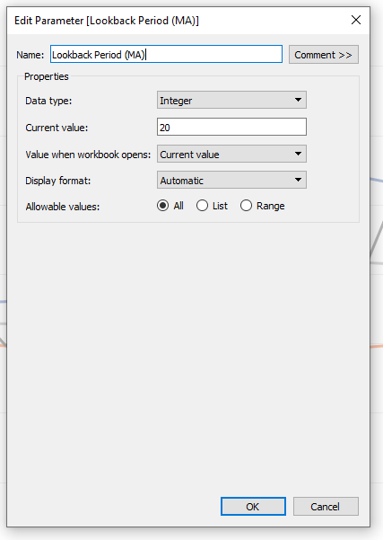
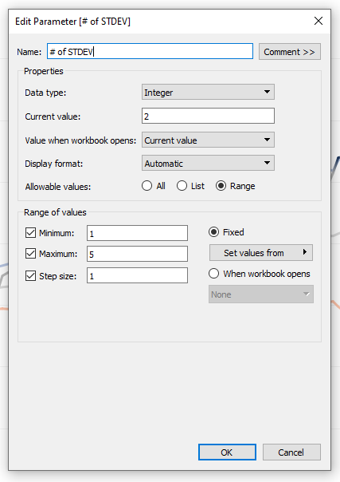
Task 3. Bollinger Bands - Parameters
The following parameters will be required to complete the Bollinger Bands visual.
Notes:
FSPBI0F Course Files Overview

Slide 36
Task 4. Traded Volume – Basics
The volume chart shows the number of shares traded on a given day.
This helps us understand the relative importance of price movements.
Price movements that occur when volume is high, suggest greater collective belief in those prices.
Price movements that occur when volume is low, suggest less long-term certainty.
The Previous Volume High tracks the running maximum in the viewing period.
Notes:
FSPBI0F Course Files Overview

Slide 37
Task 4. Traded Volume – Requirements
Sum of volume on each day shown as bar, below the candlestick (in the same worksheet)
Color coded bars to match the candlestick
Add a previous volume high measure, to give running maximum in the viewing period
Notes:
FSPBI0F Course Files Overview

Slide 38
Task 4. Traded Volume – Calculations
Calculation Formula
Volume Simply use the [Volume] column
CountDays COUNTD([Date])
CountPreviousDays RUNNING_SUM([CountDays])-1
PreviousVolumeHigh WINDOW_MAX(SUM([Volume]),-[CountPreviousDays],0)
Notes:
FSPBI0F Course Files Overview

Slide 39
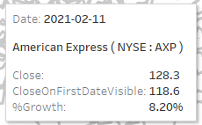
Task 5. Relative Growth - Basics & Requirements
The relative growth chart normalizes all stocks at the start of the period to help us compare relative growth.
Requirements
1) Timeline of exact dates along the X axis
2) Close price plotted with detail for each stock
3) Filter by View Period
4) User selection of Ticker to replace symbol filter
5) Tooltips as described
Notes:
FSPBI0F Course Files Overview

Slide 40
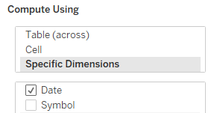
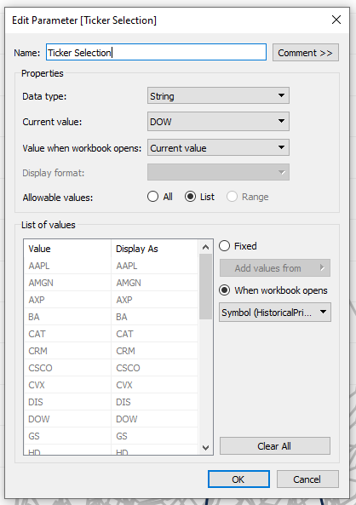
Task 5. Relative Growth - Calculations
Calculation Formula
CloseOnFirstDateVisible WINDOW_MAX(IF MAX([Date]) = MAX([FirstDateVisible]) THEN SUM([Close]) END)
Across Dates
For Each Symbol
%Growth (SUM([Close]) - [CloseOnFirstDateVisible])/[CloseOnFirstDateVisible]
Define calc options as above
Ticker Selection Parameter (see definition right)
Ticker Is Selected [Symbol] = [Ticker Selection] Used to highlight selected ticker
Finally, the following formula will need amending
CloseOnFirstDateVisible WINDOW_MAX(IF MAX([Date]) = WINDOW_MIN(MIN([Date])) THEN SUM([Close]) END)
Notes:
FSPBI0F Course Files Overview

Slide 41
Task 6. Total Growth Heat Table Requirements
The total growth heat table shows total growth for each stock over the viewing period.
1) One row per Symbol
2) Responds to user selected view period using DateFilter
3) Calculate price at the beginning and end of the period
4) Calculate and display %GrowthTotal over the view period
5) Color coded with price increase and decrease
Notes:
FSPBI0F Course Files Overview

Slide 42
Task 6. Total Growth Heat Table – Calculations
Calculation Formula
CloseOnMaxDateContext SUM(IF [Date] = [MaxDateContext] THEN [Close] END)
MinDateContext {Min([Date])}
CloseOnMinDateContext SUM(IF [Date] = [MinDateContext] THEN [Close] END)
DateFilter Promote to Context
%GrowthTotal ( [CloseOnMaxDateContext] - [CloseOnMinDateContext] ) / [CloseOnMinDateContext]
Notes:
FSPBI0F Course Files Overview

Slide 43
Trading Dashboard in Tableau - Case Study Approach
Pull Historical Prices into Tableau
Create Visuals for Intraday Prices
Create Trading Dashboard
Create Visuals for Historical Prices
Pull Intraday Prices into Tableau
Azure Data Studio
Azure Data Studio
Tableau
Tableau
Tableau

Slide 44

Pull Intraday Prices into Tableau

Slide 45
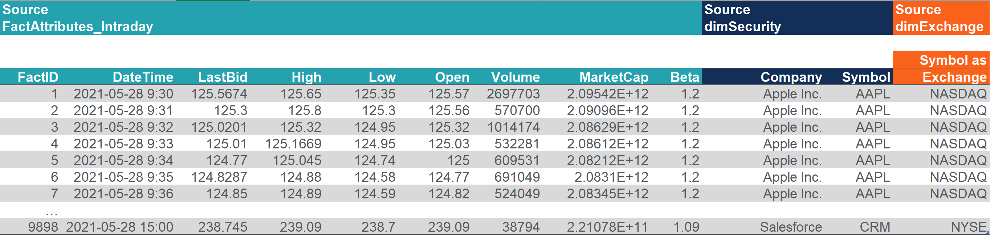
Task List: Pull Historical Prices Into Tableau
1. Connect to and Explore the intraday prices
2. Write a query to return Intraday Stock prices
3. Import the data to a new data source in Tableau by querying the view called vIntraDayPricesReporting
4. Finally, create one summary measure per column to draw out the most relevant or recent number.
Notes:
This is for the course landing page and student handout PFD. The instructor does not need to record this slide.

Slide 46
ERD – CFI Capital Partners StockPricesDW
Use the Entity Relationship Diagram to help you understand the database structure and write your queries.
Notes:
FSPBI0F Course Files Overview

Slide 47
Student Task Review: Write a Query for Intraday Prices
Below is the final query required to source intraday data from the database.
SELECT
attr.[FactID],
attr.[DateTime],
attr.[LastBid],
attr.[High],
attr.[Low],
attr.[Open],
attr.[Volume],
attr.[MarketCap],
attr.[Beta],
sec.Company,
sec.Symbol,
exc.Symbol AS Exchange
FROM [dbo].[FactAttributes_Intraday] as attr
INNER JOIN [dbo].[dimSecurity] AS sec
ON attr.SecurityID = sec.ID
INNER JOIN [dbo].[dimExchange] AS exc
ON sec.ExchangeID = exc.ID
Creating a view
To make life simpler for the database administrator, we can prepare the full code required to create the view.
To do this, we can wrap the query in the following code:
CREATE VIEW vIntraDayPricesReporting
AS
QUERY HERE
GO
Notes:
FSPBI0F Course Files Overview

Slide 48
Task 4. Intraday Summary Measures
Using the Intraday Prices dataset
Calculate the Latest Beta and call it Beta (5Y Monthly)
Calculate the latest Bid value and call it Latest Bid
Calculate the latest Market Cap value and call it Market Cap (MM)
Calculate the Maximum high value and call it Today’s High
Calculate the Minimum low value and call it Today’s Low
Calculate the first Open value and call it Today’s Open
Modify the default property formatting of each measure as appropriate
Hint: Many of the BANS metrics will need to pull the latest number from a column. You’ll need to calculate a MaxDateTime and MinDateTime as part of your calculations.
Notes:
FSPBI0F Course Files Overview

Slide 49
Task 4. Intraday Summary Measures – Calculations
MinDateTime {MIN([Date Time])}
MaxDateTime {MAX([Date Time])}
Beta (5Y Monthly) SUM(IF [Date Time]=[MaxDateTime] THEN [Beta] END)
Latest Bid SUM(IF [Date Time]=[MaxDateTime] THEN [Last Bid] END)
Market Cap (MM) SUM(IF [Date Time]=[MaxDateTime] THEN [Market Cap] END)
Today’s High {MAX([High])}
Today’s Low {MIN([Low])}
Today’s Open SUM(IF [Date Time]=[MinDateTime] THEN [Open] END)
Notes:
FSPBI0F Course Files Overview

Slide 50
Trading Dashboard in Tableau - Case Study Approach
Pull Historical Prices into Tableau
Create Visuals for Intraday Prices
Create Trading Dashboard
Create Visuals for Historical Prices
Pull Intraday Prices into Tableau
Azure Data Studio
Azure Data Studio
Tableau
Tableau
Tableau

Slide 51

Create Visuals for Intraday Prices

Slide 52
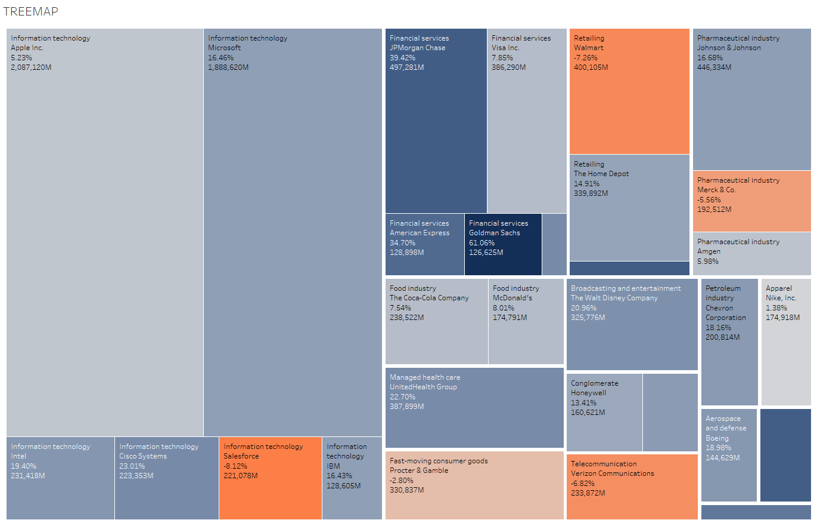
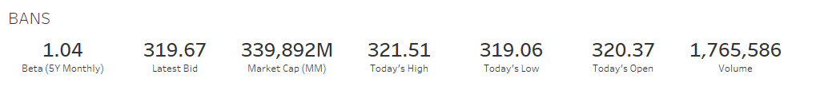
Task List: Create Visuals for Intraday Prices
1. Create a BANS Visual to highlight key intraday metrics
2. Create a Treemap to highlight performance by stock and industry
Notes:
This is for the course landing page and student handout PFD. The instructor does not need to record this slide.

Slide 53
Task 1. BANS - Basics & Requirements
Our BANS visual helps to highlight key figures from the intraday dataset
Requirements
Use the IntradayPrices dataset
Display the following measures in the visual: Beta (5Y Monthly), Latest Bid, Latest Market Cap, Today’s High, Today’s Low, Today’s Open, Sum of Volume
Modify the default property formatting of each measure if necessary
Notes:
FSPBI0F Course Files Overview

Slide 54
Task 1. BANS – Calculations
MinDateTime
MaxDateTime
Beta (5Y Monthly)
Latest Bid
Market Cap (MM)
Today’s High
Today’s Low
Today’s Open
Volume Simply use the volume column
Ticker Is Selected [Symbol] = [Ticker Selection] Used to filter selected ticker
Ticker Is Selected Promote to Context Filter (so that the worksheet data represents one ticker only)
Notes:
FSPBI0F Course Files Overview

Slide 55
Task 2. Treemap Basics and Specification
The treemap helps us gauge the relative importance of each stock in the Dow Jones.
1) One square of detail per ticker (historical data)
2) Color defined by %GrowthTotal (historical data)
3) Size defined by MarketCap (intraday data)
4) Industry, Company & Measures to Labels
5) Filter by dates using DateFilter
Note: To combine datasets in one visual you will need to use a technique called data blending.
Notes:
FSPBI0F Course Files Overview

Slide 56
Task 2. Treemap – Calculations
Calculation Formula
Ticker From HistoricalPrices dataset
%GrowthTotal From HistoricalPrices dataset
Must blend data at this point (Historical as primary, Symbol as Join Key)
MarketCap From Intraday Dataset
DateFilter Promote to context
Notes:
FSPBI0F Course Files Overview

Slide 57
Data Blending
Fact tables in a single data source must be of the same grain. Grain defines the lowest level of detail.
Grain of HistoricalPrices dataset = Ticker Price by Day
Grain of IntradayPrices dataset = Ticker Price by Minute
Due to having different grains, these two datasets must be used in different datasets.
Symbol | %GrowthTotal
AAPL | %
AMGN | %
AXP | %
BA | %
CAT | %
MartketCap
$
$
$
$
$
Since we cannot JOIN or create relationships between the two datsets, we must use Data Blending.
Data Blending does not change the presentation of the Primary Data set visual.
Data Blending returns a value for each JOIN KEY of the primary viasual, acting like a LEFT JOIN to summarize the secondary dataset.
To use data blending in Tableau, goto Data → Edit Blend Relationships
Notes:
FSPBI0F Course Files Overview

Slide 58
Trading Dashboard in Tableau - Case Study Approach
Pull Historical Prices into Tableau
Create Visuals for Intraday Prices
Create Trading Dashboard
Create Visuals for Historical Prices
Pull Intraday Prices into Tableau
Azure Data Studio
Azure Data Studio
Tableau
Tableau
Tableau

Slide 59

Create Trading Dashboard

Slide 60
Task List: Create Trading Dashboard
1. Check all filters work correctly and place the basic charts on a fixed size canvas
2. Create a pop-up container for the treemap
3. Bonus: Create a second pop up container to display a ticker focused news feed
Notes:
This is for the course landing page and student handout PFD. The instructor does not need to record this slide.

Slide 61
Dashboard Requirements Part 1
Check that the filters are setup correctly, and all relevant charts respond to the filters.
Historical Visuals
Candlestick Filters
- DateFilter True
- TickerIsSelected True
Bollinger Band Filters
- DateVisibility True
- TickerIsSelected True
Pct Growth / Relative Growth Filters - DateFilter True
- Show all tickers
Total Growth Heat Filters
- DateFilter True & Promoted to Context
Intraday Visuals
BANS Filters
- TickerIsSelected True & Promoted to Context
Treemap Filters
- DateFilter True & Promoted to Context
- Show all tickers
Notes:
FSPBI0F Course Files Overview

Slide 62
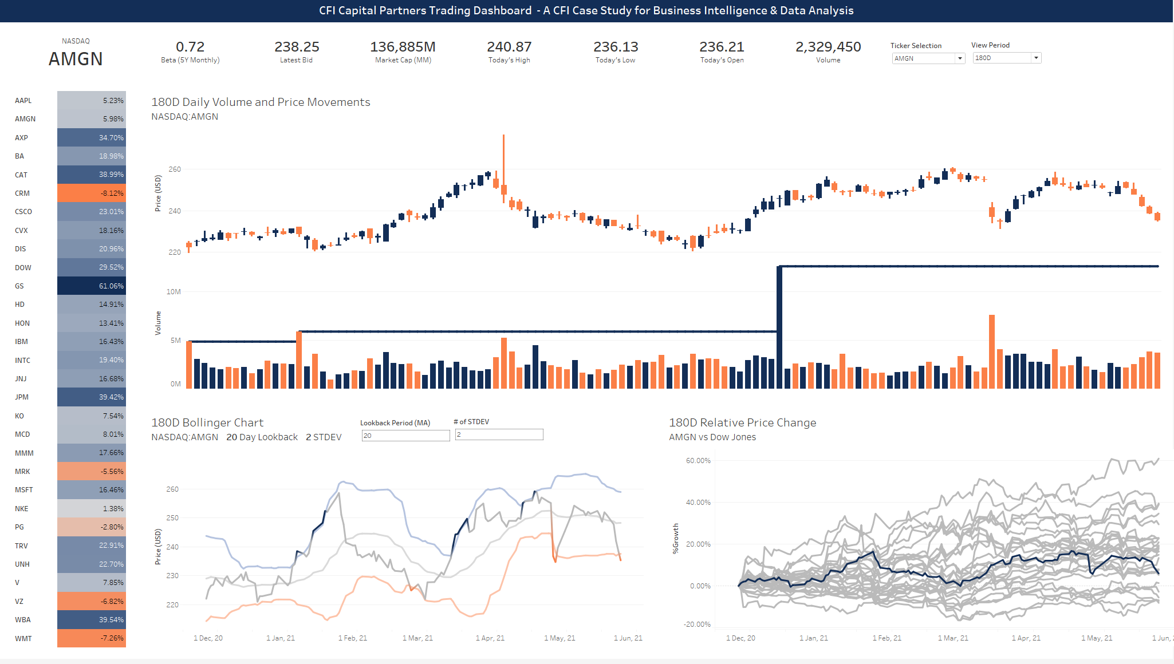
Dashboard Requirements Part 1
Create a fixed size floating dashboard.
Display Candlestick, Bollinger bands, Relative Growth, Total Growth Heat and BANS by default.
Display parameter selection for Ticker and View Period in top right
Create dynamic titles for the three large visuals that adds ticker and period info.
Display parameter selection for Lookback and StDev in the Bollinger Chart
Create Visual to display Selected Ticker in the top left.
Add a title to your dashboard (we would appreciate it if you used the proposed title below.
CFI Capital Partners Trading Dashboard - A CFI Case Study for Business Intelligence & Data Analysis
Notes:
FSPBI0F Course Files Overview

Slide 63
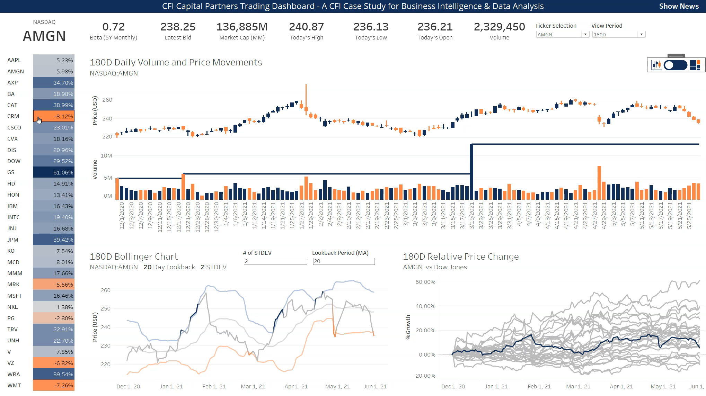
Dashboard Requirements Part 2
Create a white pop-up container to cover the candlestick chart.
Place the treemap in the container using the shift key as you drag it.
Add a show/hide button for the container, make it float at the front and make it look professional using the images provided.
Notes:
FSPBI0C – Video Call with Project Sponsor
Meeyeon Video Recording

Slide 64

Project Requirements Part 3
Create a white pop-up container to cover everything except the title.
Add a web page to the container that shows the news for a specific ticker.
Make the URL responsive to the selected ticker parameter.
Add a parameter action to the dashboard so that the ticker parameter is updated when you select an item in the heat visual.
Notes:
FSPBI0C – Video Call with Project Sponsor
Meeyeon Video Recording

Slide 65
Dashboard Coordinates (2048 x 1152)
X 0 y 0 W 2048 h 40
X 20 y 40
W 225 h 110
X 240 y 40
W 1300 h 100
TICKER
BANS
X 260 y 160
W 1768 h 520
X 20 y 160
W 200 h 972
CANDLE & TREE CONTAINER
TOTAL %
X 260 y 720
W 864 h 410
X 1164 y 720
W 900 h 410
BOLLINGER
RELATIVE %
You may resize the dashboard once it is created. You may need to adjust font sizes etc.
Notes:
FSPBI0F Course Files Overview

Slide 66
Alternative Strategies for Sourcing Data

Slide 67
Other Slides

Slide 68
Key Concepts Filters – Order of Operation
Data Source Filters
Filters are executed according to the order of operation.
Dimension filters can be promoted to context filters.
Context Filters
Top N, Sets, Conditional Filters & Fixed LOD
Dimension Filters
Include / Exclude LOD, Data blending
Measure Filters
Table Calcs, Totals, Forecasts

Slide 69

Tableau Order of Operations
DATA SOURCE
CONTEXT = THE AVAILABLE DATA IN A WORKSHEET
LODs
Dimension Filters
Data Source Filters
DIMENSION = DATA AVAILABLE FOR MOST CALCULATIONS
DATA AVAILABLE FOR CREATING VISUALS
BASIC MEASURES
Context Filters
MEASURE 2
Notes:
This is optional – for organizational purposes. Hide this slide from the students.

